Slide 1

Department of Information Technology
A.P. Shah Institute of Technology
G.B.Road,Kasarvadavli, Thane(W), Mumbai-400615
UNIVERSITY OF MUMBAI
Academic Year 2019-2020

Slide 2
A Project Report on
DRIVER DROWSINESS AND ALERT SYSTEM
Submitted in partial fulfillment of the degree of
Bachelor of Engineering(Sem-7)
in
INFORMATION TECHNOLOGY
By
Saylee Patne(16104021)
Riya Sangal(16104014)
Yashashree Gore(17204009)
Under the Guidance of
Prof.Anagha Aher

Slide 3
1.Project Conception and Initiation

Slide 4
1.1 Abstract
Drowsy driving is one of the major cause for road accidents. Hence, detection of drivers fatigue and its indication is an active research area. Therefore, in this study, a low cost ,real time drivers drowsiness detection system is developed with acceptable accuracy. In the developed system, a front camera of drivers cell phone records the video and drivers face is detected. For this, eyes, nose and mouth are detected to improve the area of interest using Google Vision API. For creating an app android studio alternative b4a is used. When the drowsiness is detected, then the driver is alerted by audio.

Slide 5
1.2 Objectives
It can be used for the safety of driver while driving which reduces accidents and detects drowsiness of the driver.
To generate alerts to the driver by playing loud music.
To enhance the safety of the driver.
To monitor driver fatigue and alert him\her when drowsiness situation is detected.
To capture the frames from video and detect drowsiness.

Slide 6
1.3 Literature Review
Sr. No. | Title and Author of the paper | Advantages | Drawbacks
1 | Driver Drowsiness Monitoring System using Visual Behavior and Machine Learning Authors- Ashish Kumar, Rusha Patra | Using facial points, drowsiness is detected. It uses HOG algorithm. Machine Learning is used which gives more accuracy. | Uses webcam which requires high level image processing to focus the visuals.
2 | An Accurate ECG Based Transportation Safety Drowsiness Detection Scheme Authors- Kwok Tai Chui, Kim Fung Tsang, Hao Ran Chi, Bingo Wing Kuen Ling, and Chung Kit Wu | HOG(Histogram of oriented gradient) algorithm is used. Sensors are used for detection. | The required computational power of the system is low enough for the real time application.

Slide 7
1.3 Literature Review
Sr. No. | Title and Author of the paper | Advantages | Drawbacks
3 | Eye Gaze Tracking Based Driver Monitoring System Authors: Annu George Mavel, J.E Judith, Sahal P, Steffy Ann Kuruvilla | Face And Eye Detection is done. Along with audio, steering vibration warning is also given to the driver | This project uses Raspberry Pie which needs more power supply and uses sensors which increases the cost of the product.
4 | A Multimodal System for Assessing Alertness Levels due to Cognitive Loading Authors: Anwesha Sengupta , Anirban Dasgupta, Aritra Chaudhari | Low Cost. | Use Sensors for detecting drowsiness

Slide 8
1.4 Problem Definition
The main purpose of this project is to develop an application for drowsiness of the driver.
Nowadays more accident occurs in vehicles due to drowsiness. That’s why this system is proposed for reducing accidents.
We are implementing a system where the app will capture the video of driver’s face on basis of image processing techniques. After drowsiness detection alerts will be send to the driver.
Instead of using hardware components like webcam, we will be implementing on mobile app.

Slide 9
1.6 Technology stack
Google Vision API
It allows developers to easily integrate vision detection features within applications, including image labelling, face and landmark detection.
B4A
Alternative of Android Studio. It describes as Rapid development tool. Used for application development.

Slide 10
1.7 Benefits for environment & Society
Helps to avoid crashes caused by fatigue by drivers to take a break in time.
Warns the driver of drowsiness and sends alert.
To ensure the safety of the driver.

Slide 11
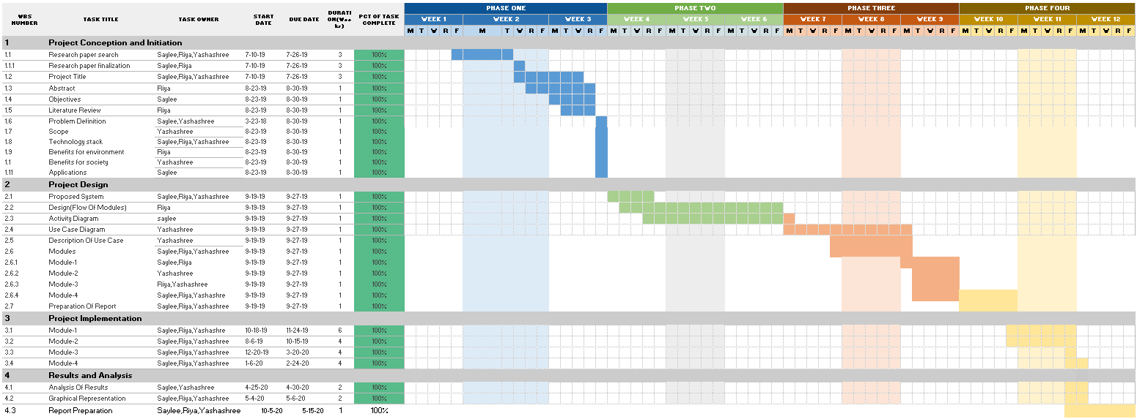
Gantt Chart & Project Timeline Chart

Slide 12
2. Project Design

Slide 13
2.1 Proposed System
In this we have proposed a mobile application for detection of driver’s drowsiness. When the application starts, it asks for camera permissions.
Video recording starts, it is done in frames.
These frames are extracted using google vision api features.
The region of Interest(like-eye, mouth, nose) is extracted and calculation is done for determining the ratio of height and width of the region.
The probability of region of interest is calculated.
If the probability is less than 50% then alert is send.

Slide 14
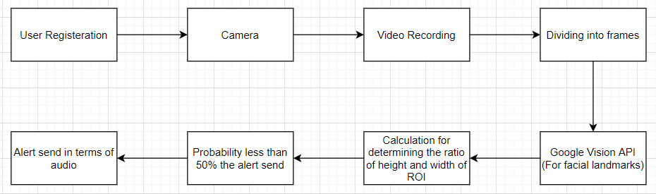
2.2 Design(Flow Of Modules)

Slide 15
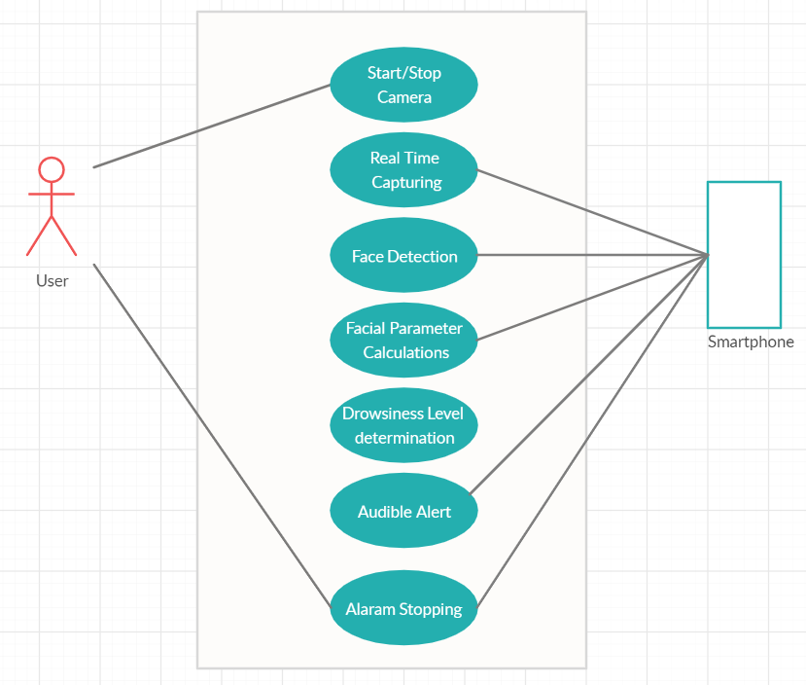
2.3 Use Case Diagram

Slide 16
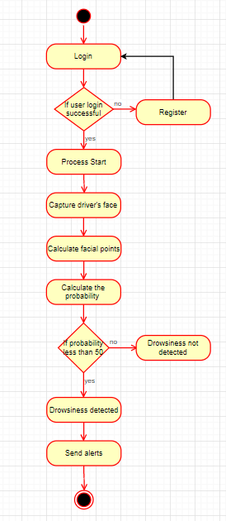
2.4 Activity Diagram

Slide 17
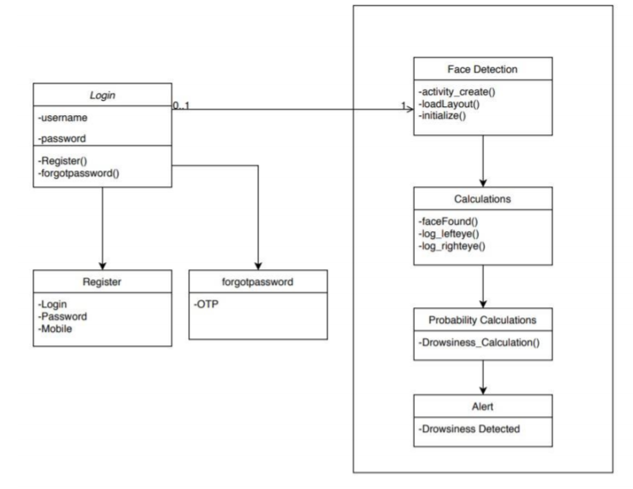
2.4 Class Diagram

Slide 18
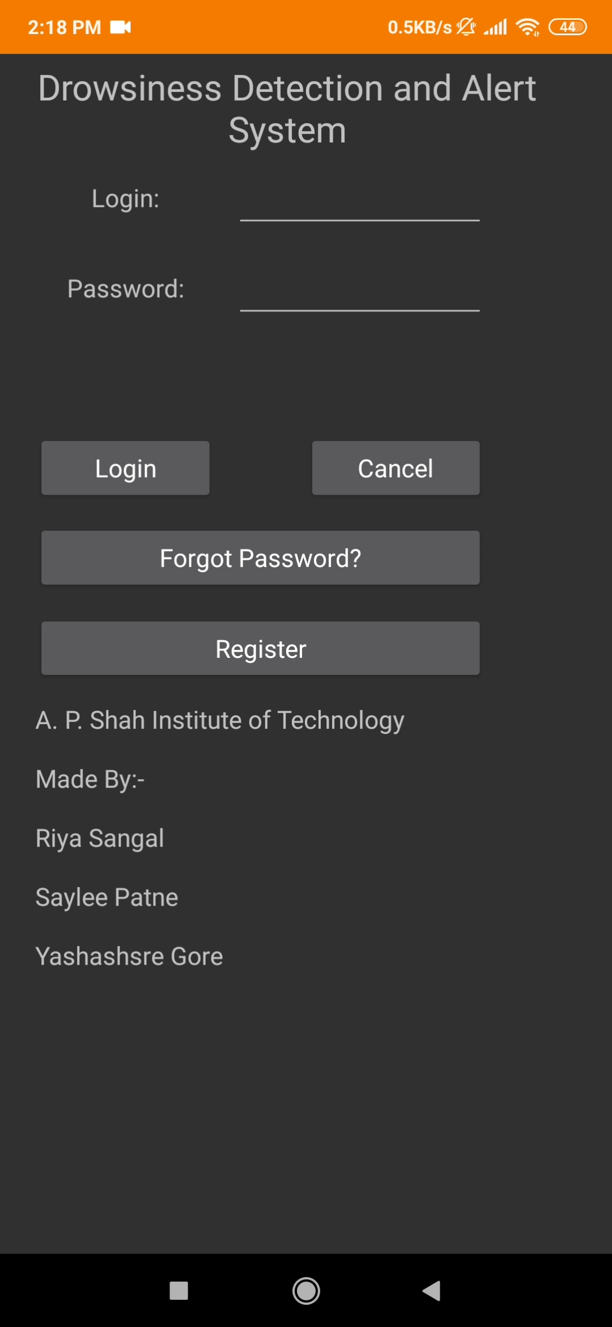
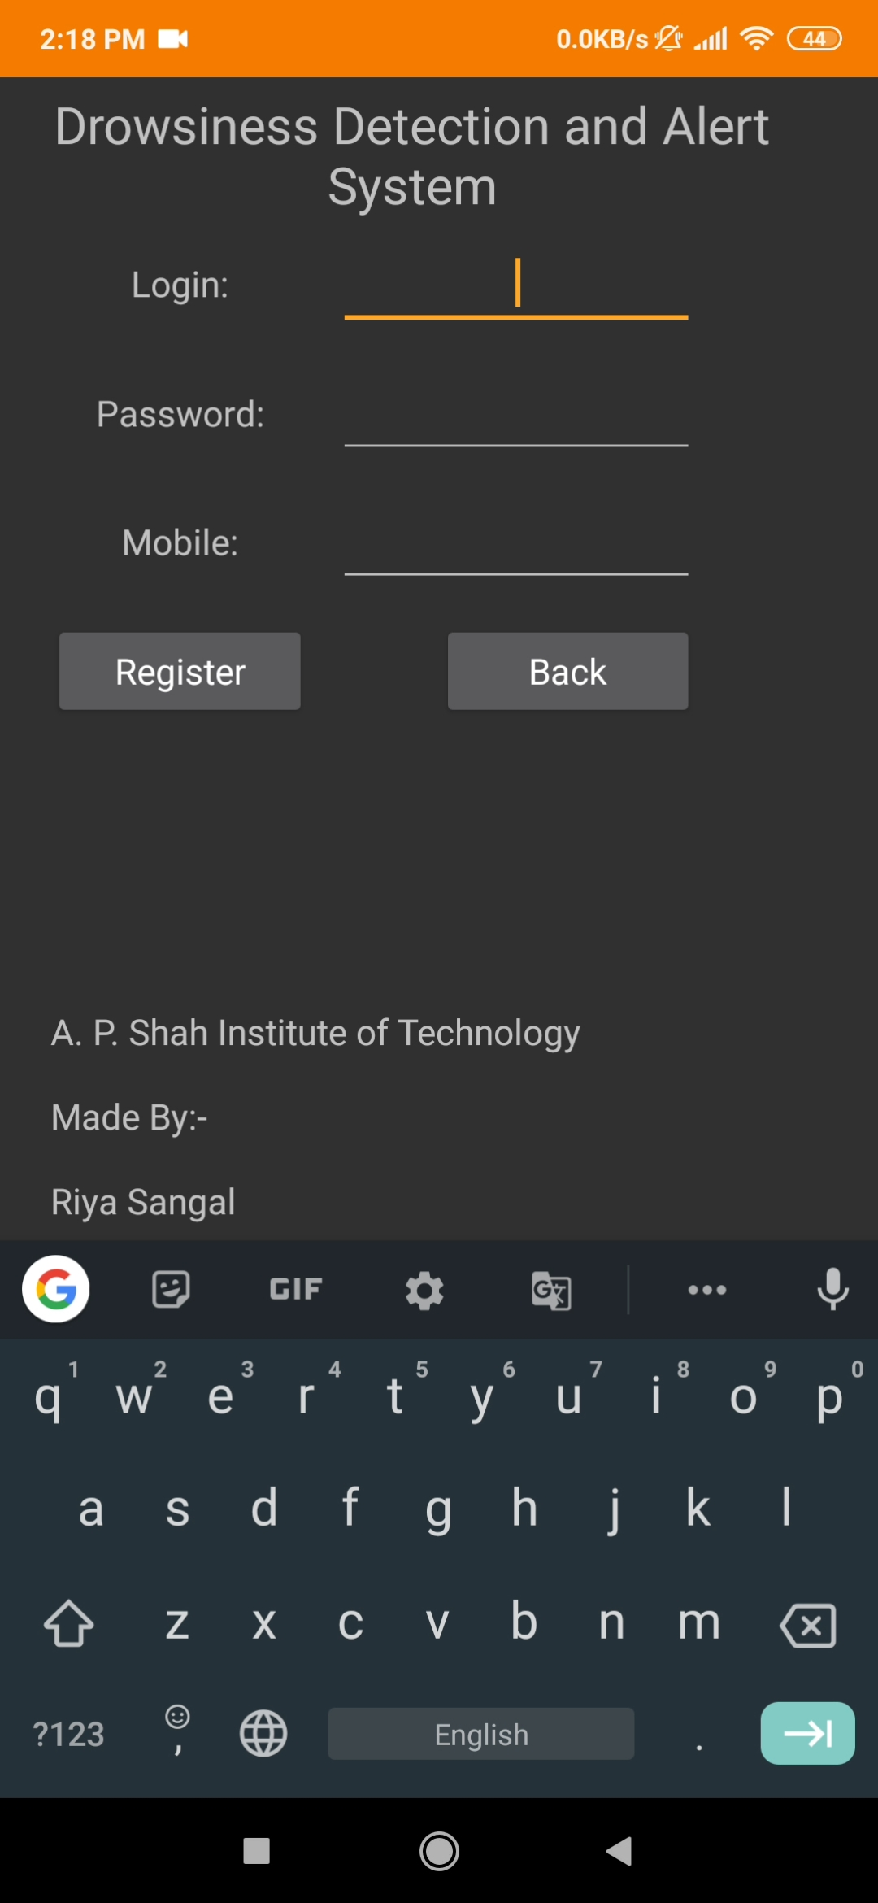
2.5 Module-1: Registration of User
The first thing after opening the app is, user must login to its account. If user is new then he/she should register first.

Slide 19
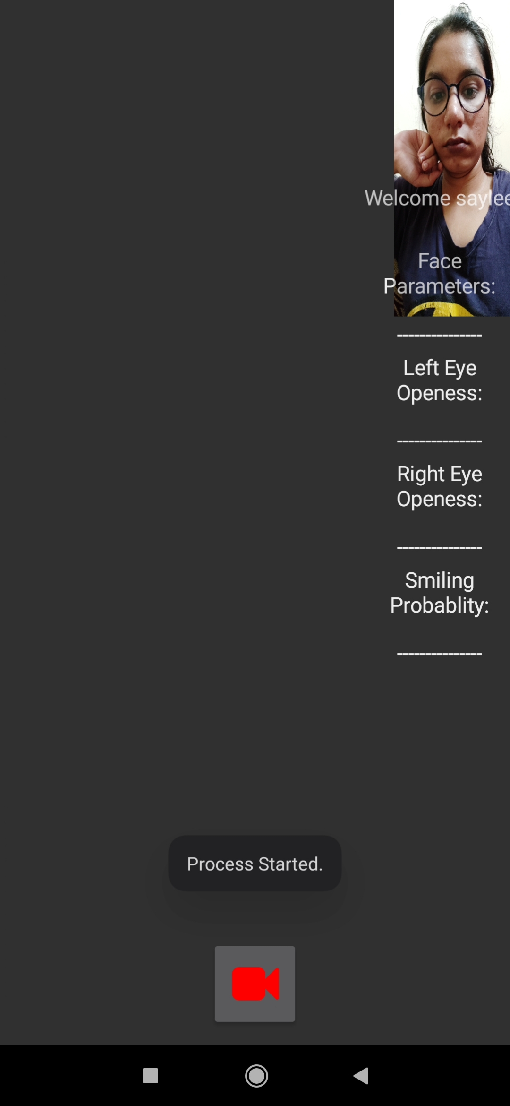
Module-2: Google Vision API
It has libraries to easily integrate vision detection features within applications, including image labelling, face and landmark detection.

Slide 20
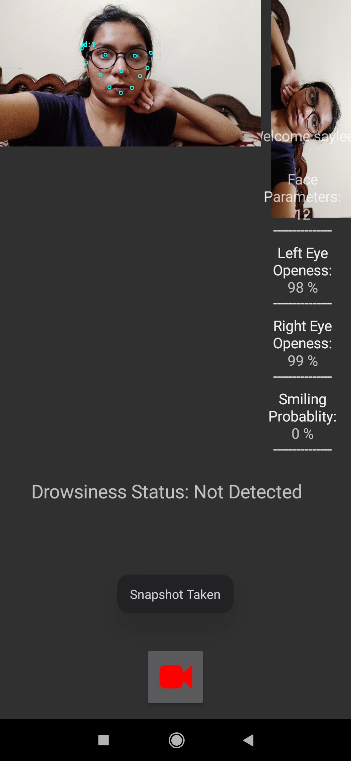
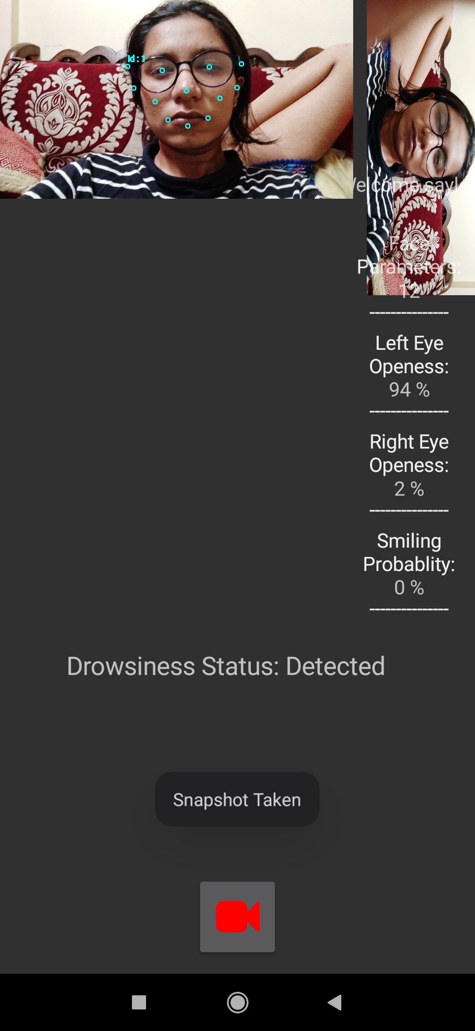
Module-3: Drowsiness detection
Alert send when drowsiness is detected or else not.

Slide 21
3.Future Scope

Slide 22
Future Scope
Using Pressure sensor on the steering alarm, Automatic braking System can be set in case of drowsiness.
By using wireless Technology if the driver gets drowsy an alert message can be sent to a selected person’s mobile by using GSM module along with the alarm in vehicle.
Development of a hybrid microcontroller for a vehicle which also consists of a alcohol detector which will sense is the driver is drunk and would not start the vehicle.

Slide 23
Conclusion
We have proposed a mobile app which will be helpful in drowsiness detection.
The app captures the video of drivers face in frames and Google Vision API will be applied on these frames.
No use of sensors
Application will be free of cost , hence cost is very much effective.
When the frames are captured and calculation is done on the region of interest (eg. eyes) to determine the ratio of height and width of the region and on that basis detection is done and if the probability is less than 50% then alerts are sent.

Slide 24
References
Ashish Kumar and Rusha Patra, “Driver Drowsiness Monitoring System using Visual Behaviour and Machine Learning”, IEEE, 2018
Annu George Mavely, J.E Judith, Sahal P A, Steffy Ann Kuruvilla, “Eye Gaze Tracking Based Driver Monitoring System”, IEEE, 2017
Kwok Tai Chui, Kim Fung Tsang, Hao Ran Chi,Bingo Wing Kuen Ling, and Chung Kit Wu, “An Accurate ECG Based Transportation Safety Drowsiness Detection Scheme”, IEEE, 2016
Anwesha Sengupta, Anirban Dasgupta, Aritra Chaudhuri, Anjith George, Member, IEEE, Aurobinda Routray, Rajlakshmi Guha, A Multimodal System for Assessing Alertness Levels due to Cognitive Loading, IEEE 2016

Slide 25
Thank You

